Slide 1
Bootstrapping Food Equity
100 Rural Women & Dani Pieratos
February 16, 2022
830am-930am

Slide 2
Dani Pieratos
From Lake Vermilion Reservation, District II Bois Forte Band of Chippewa
Helps with:
Harvest Nation Inc.
Land Access Alliance
Bois Forte Food Sovereignty & Sustainable Agriculture Group
Mazaan Tea

Slide 3
Desperation, Surrender, Patience, Love, Trust, Resourcefulness

Slide 4
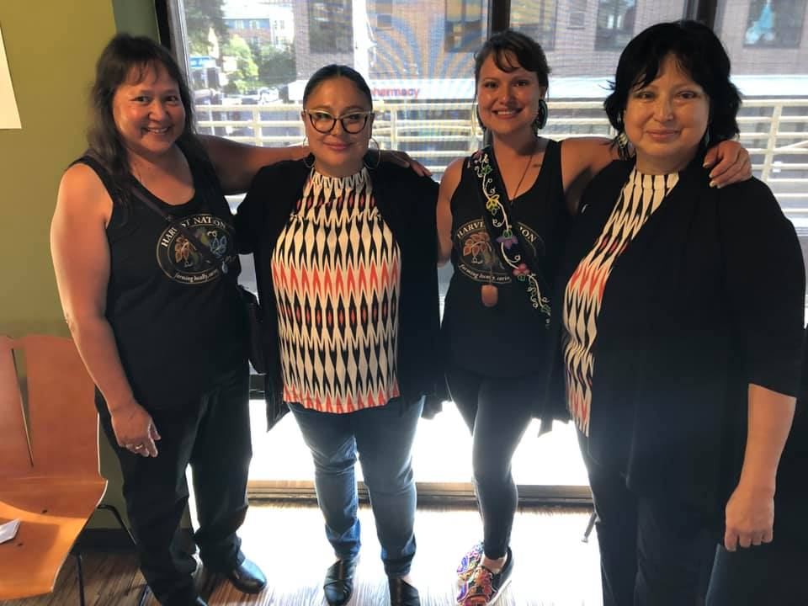
Desperation, Surrender, Patience, Love, Trust, Resourcefulness

Slide 5
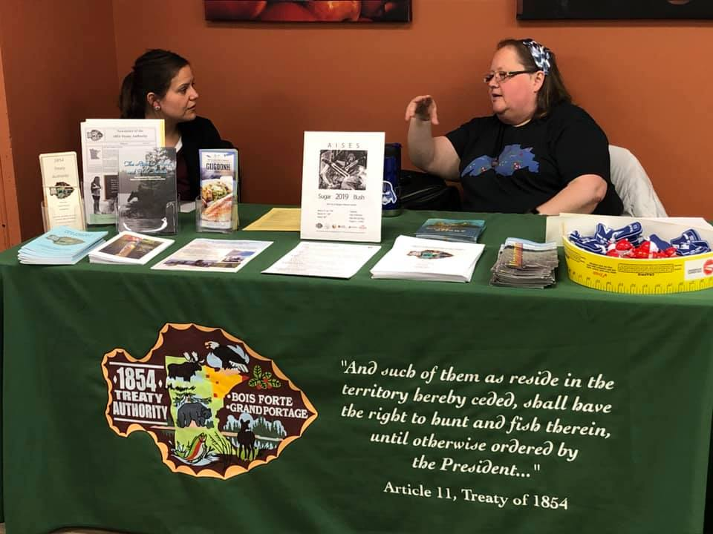
Desperation, Surrender, Patience, Love, Trust, Resourcefulness

Slide 6
Desperation, Surrender, Patience, Love, Trust, Resourcefulness

Slide 7
Desperation, Surrender, Patience, Love, Trust, Resourcefulness

Slide 8
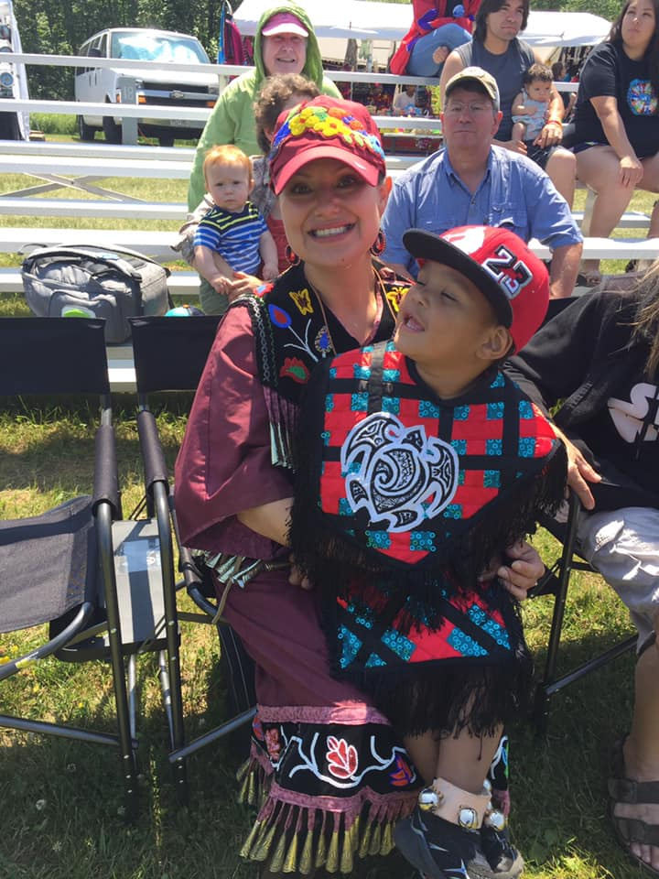
Desperation, Surrender, Patience, Love, Trust, Resourcefulness

Slide 9
Desperation, Surrender, Patience, Love, Trust, Resourcefulness

