Slide 1
100 in 100 Project
Updated
Dec.. 12th, 2020
Notes:
Hello. Thank you for joining me today to learn a little bit about our Pilot of the 100 in 100 Project.

Slide 2
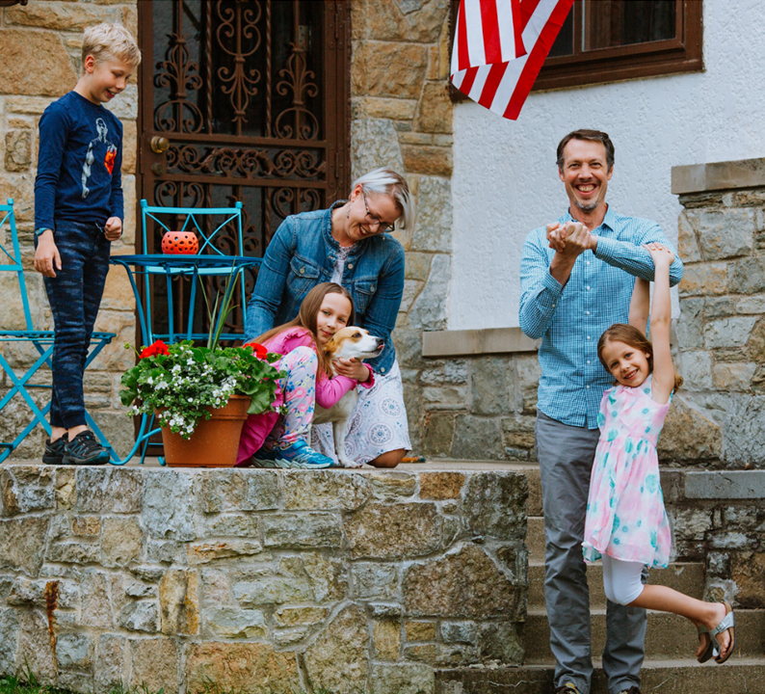
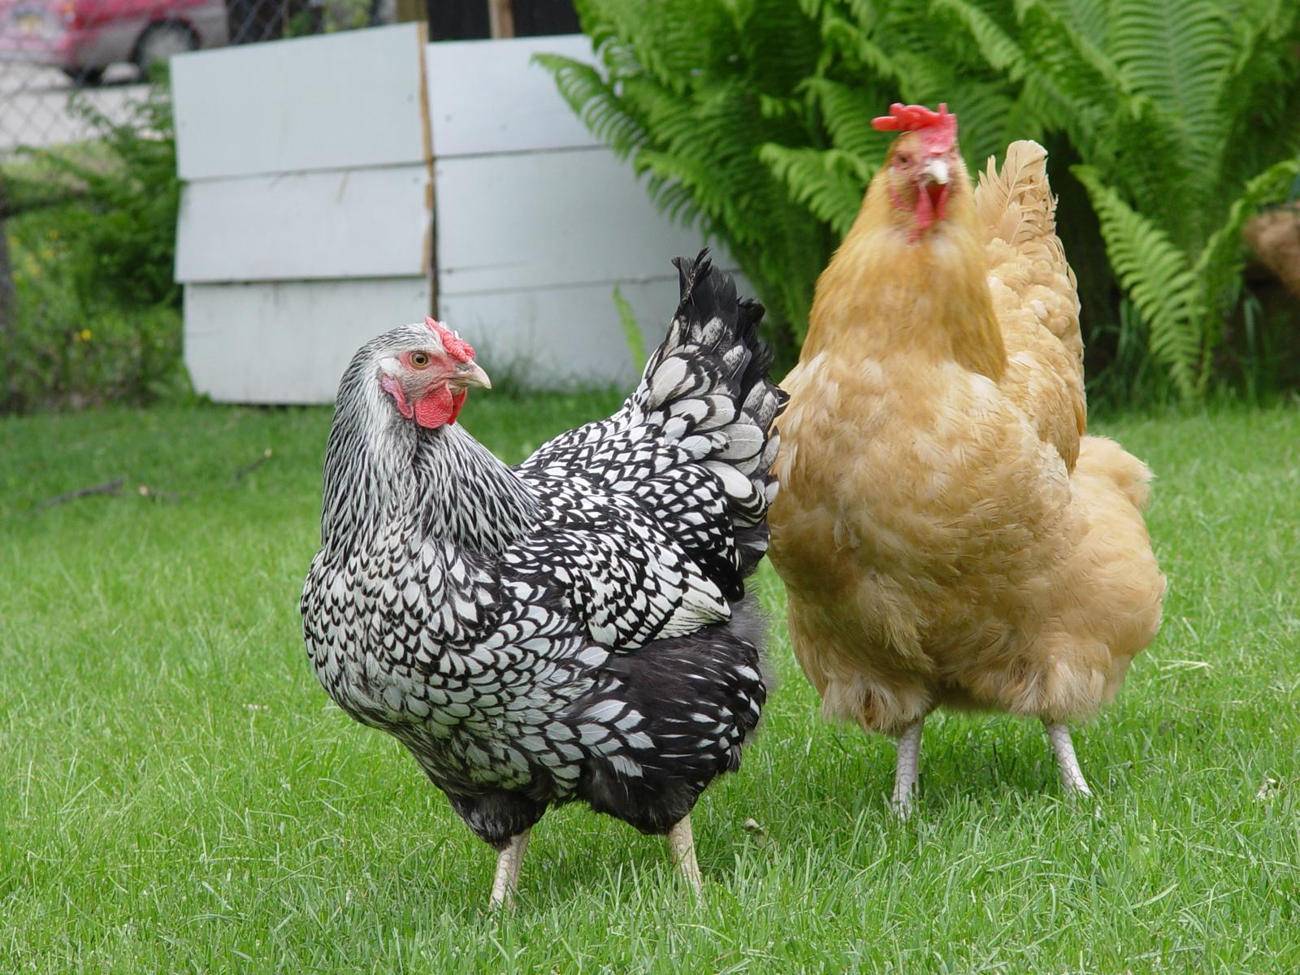
Introduction
Kate Stower
Former educator
Mom, wife…
Cancer survivor
Graduate student
Notes:
Let me start by introducing myself. My name is Kate Stower and I am a
Former educator-- I taught high social studies in Bemidji, worked at the Minnesota Historical Society, and supported educators at Minnesota Department of Education.
I am the wife of one very patient husband-- especially when I announced I wanted to quit my job and go back to school.
I am the mom of three wonderful kids, 1 dog, and two chickens.
I am a cancer survivor-- which started me off on this journey to make a career switch I had been considering for a long time.
For the past three years I have been a graduate student in the Urban and Regional Planning Program at the U of M-- focusing on rural development and public engagement.
I am especially interested in finding creative ways to engage diverse groups who have been historically underrepresented in community leadership-- including women, people of color, and new immigrants.

Slide 3
100 Rural Women
Notes:
I was fortunate enough to get hired by Teresa Kittridge last fall as a graduate research assistant, and have learned so much from both Teresa and our project partner from RSDP, Linda Kingery.
This project was a culmination of so many things I have explored over the course of my graduate studies. Our team was constantly challenging one another to find more equitable and effective methods of community engagement that would help lift up rural women. I will forever be grateful for their support and mentorship, echoing so many of the women in this study who commented on the value of these resources.

Slide 4
Are there fewer women in leadership roles?
Notes:
Despite women making up 50% of Minnesota’s population, women are underrepresented in national, state, and local elected positions.
Only 17%-- less than one fifth-- of county board chairs and Minnesota mayors are women.
Even in a female- dominated field like education only one quarter of Superintendents are women.

Slide 5
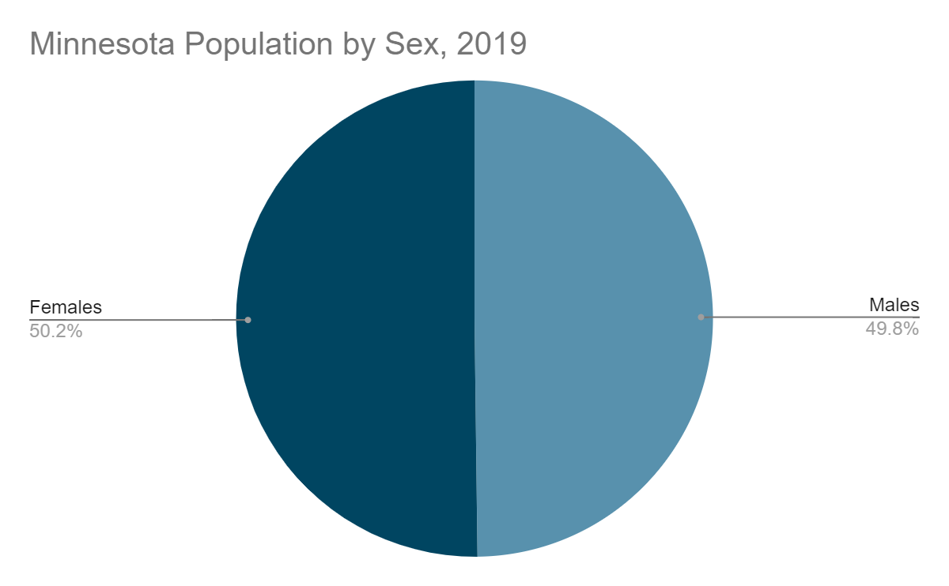
Minnesota Population
Minnesota Population: 5.7 million people
Source: U.S. Census Bureau

Slide 6
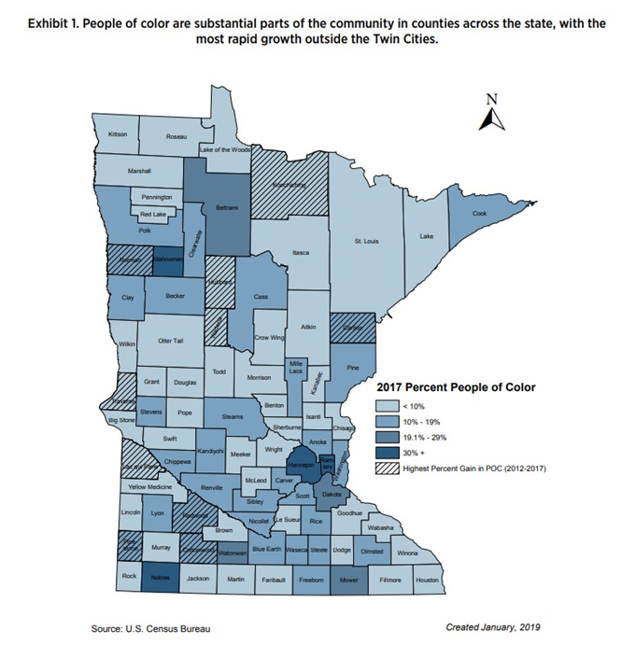
Minnesota Population
Greater Minnesota is rapidly
becoming more diverse.

Slide 7
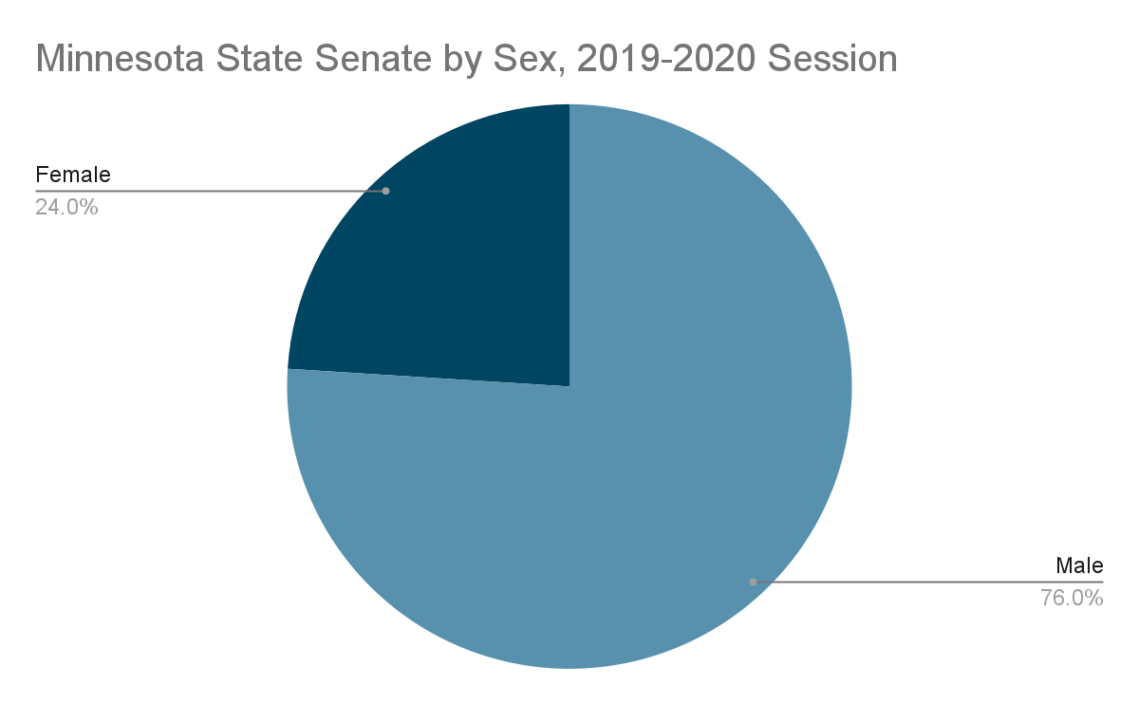
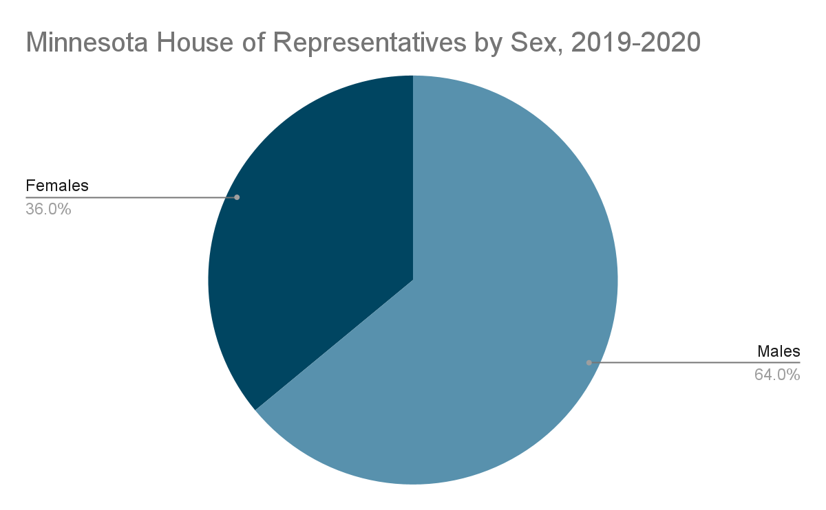
State Political Offices
Notes:
Women in state offices (2019-2020 session)
16 of the 67 State Senators (24%)
48 of the 134 Representatives (36%)

Slide 8
State Political Offices
Notes:
Majority of state court judges are men
POC and Native Americans are underrepresented

Slide 9
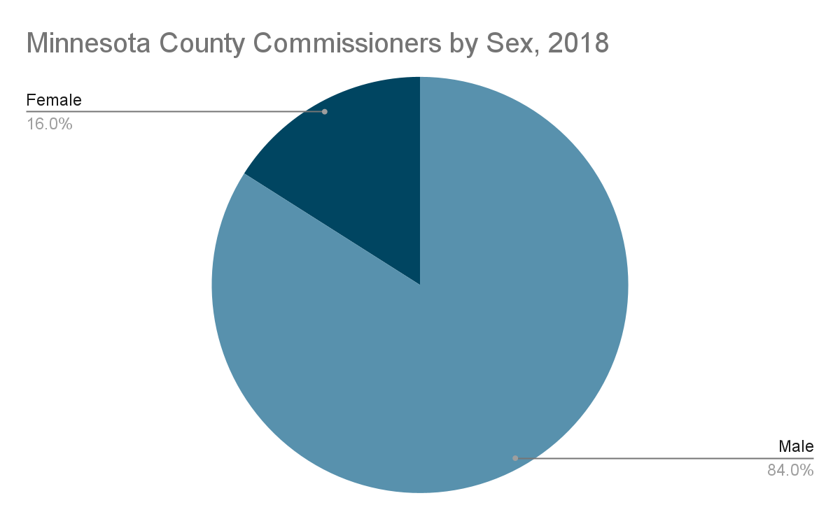
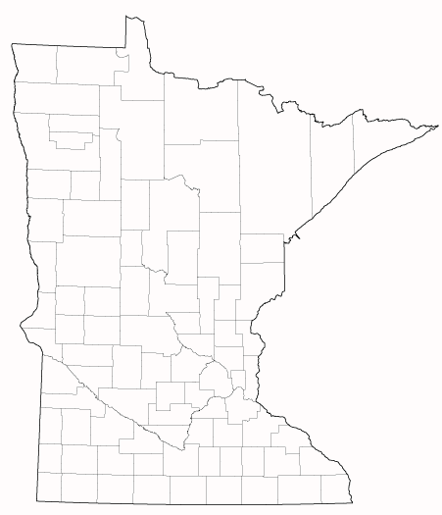
County Political Offices
Status of Women and Girls in Minnesota- Report 2020
https://www.wfmn.org/research-status-of-women-and-girls-in-minnesota/
Notes:
Women in 2018 state county commissioner races
18.4% of all candidates
15.8% of winners in the November
Women comprise just 17.2% of all county board chairs in Minnesota

Slide 10
Local Leadership
Status of Women and Girls in Minnesota- Report 2020
https://www.wfmn.org/research-status-of-women-and-girls-in-minnesota/
Notes:
Only 17% of Minnesota cities have female mayors
72% of K-12 educators nationwide are women, just 27% of superintendents are women

Slide 11
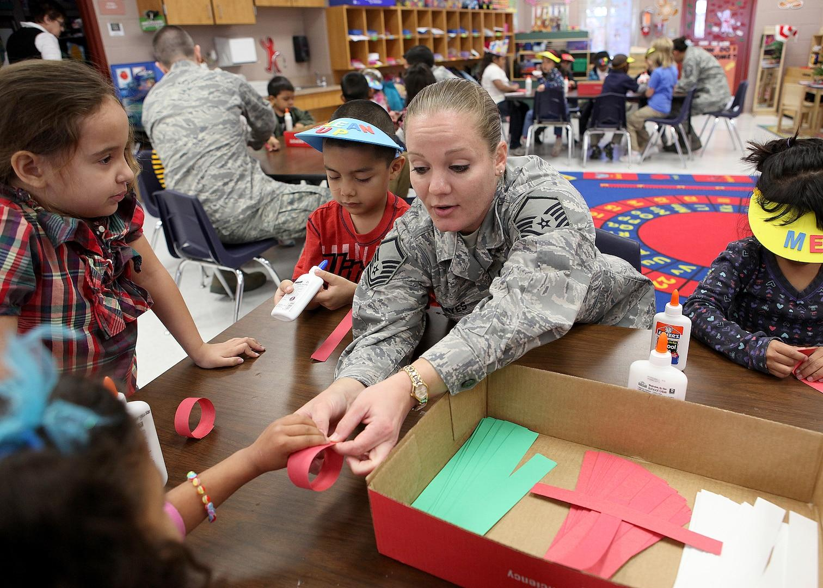
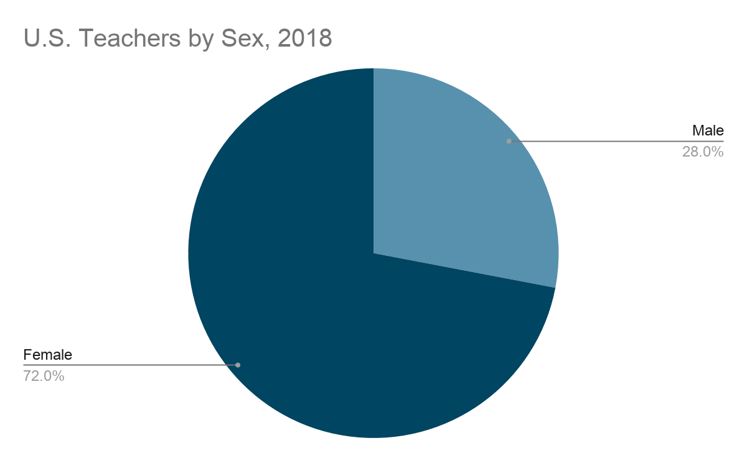
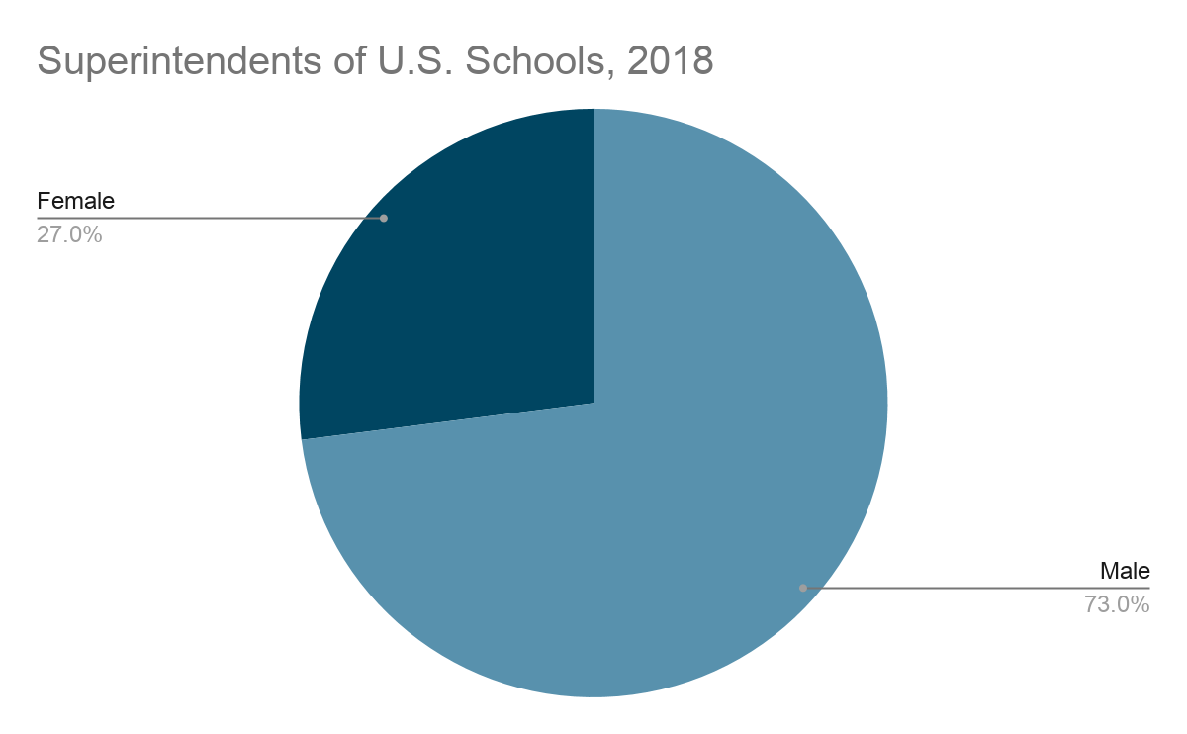
Education
Status of Women and Girls in Minnesota- Report 2020
https://www.wfmn.org/research-status-of-women-and-girls-in-minnesota/
Notes:
72% of K-12 educators nationwide are women, just 27% of superintendents are women

Slide 12
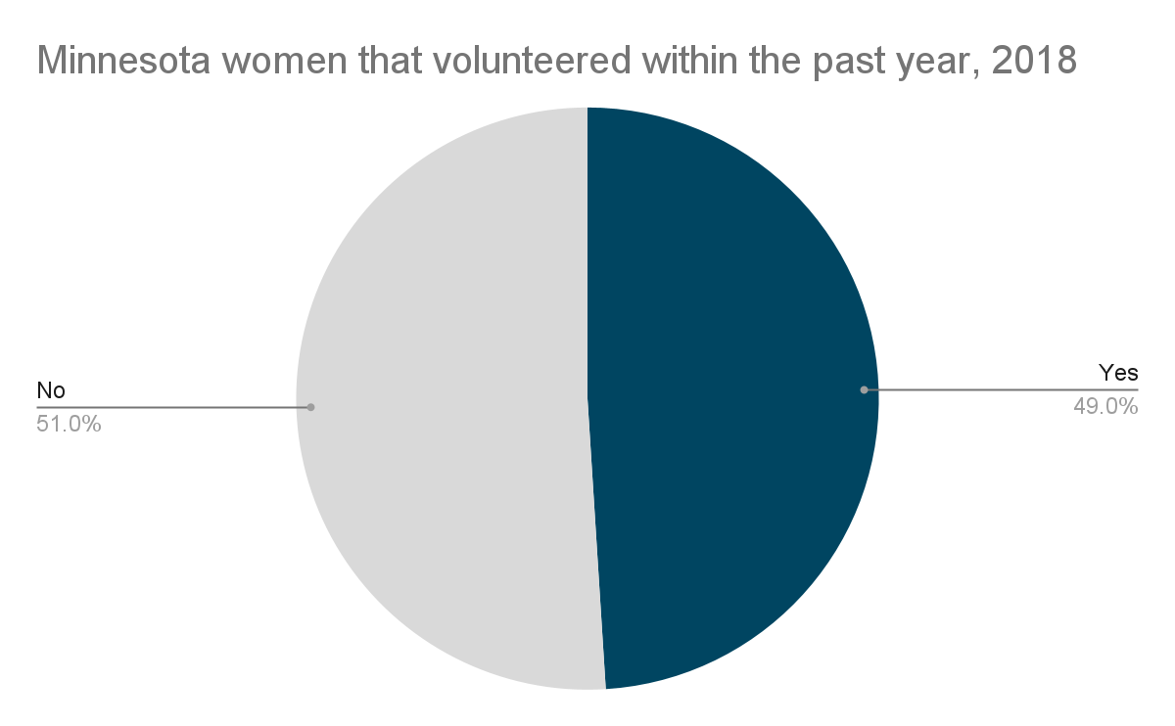
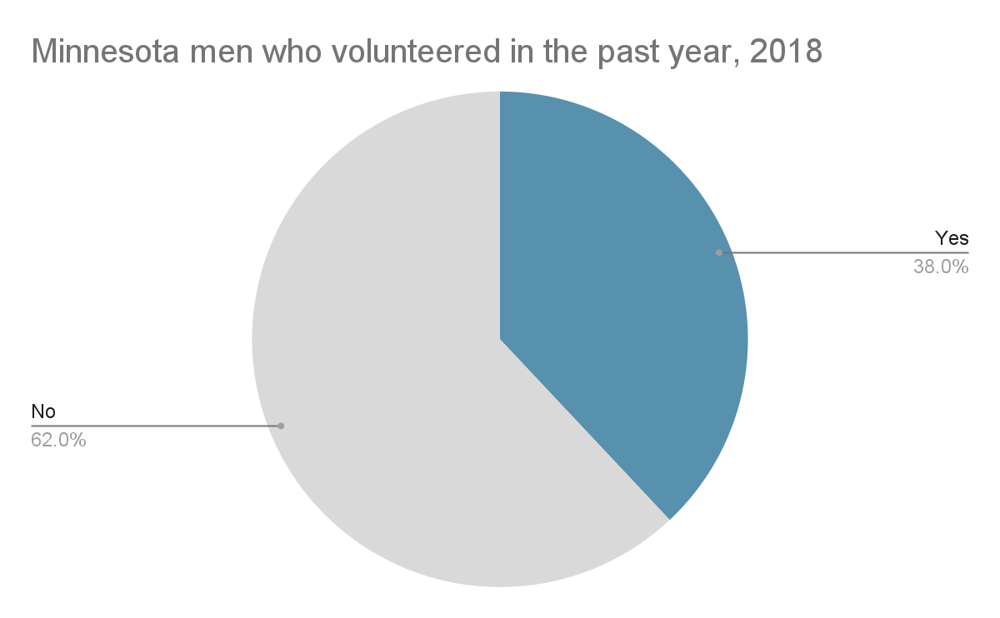
Civic engagement
Status of Women and Girls in Minnesota- Report 2020
https://www.wfmn.org/research-status-of-women-and-girls-in-minnesota/
Notes:
49% of Minnesota women volunteered within the past year, compared to 38% of men

Slide 13
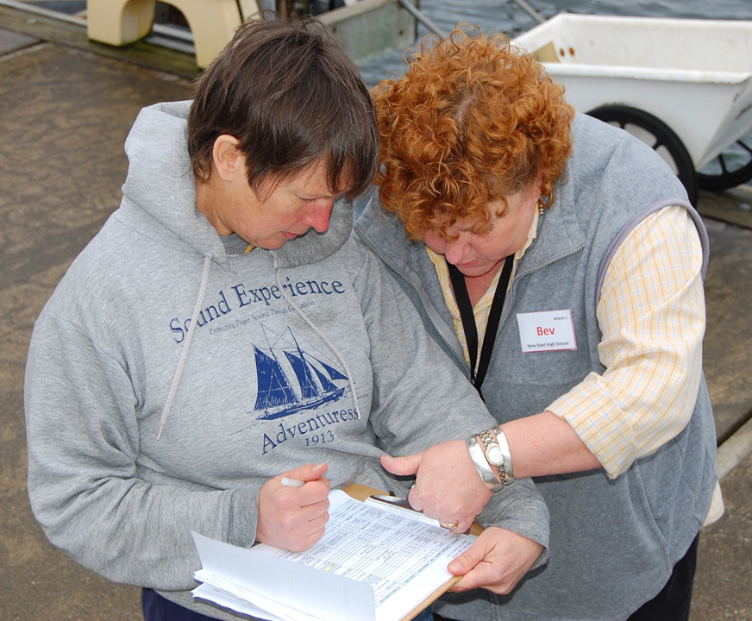
Why women in leadership?
Work harder
More legislation
Women, children, families
More money for District
Status of Women and Girls in Minnesota- Report 2020
https://www.wfmn.org/research-status-of-women-and-girls-in-minnesota/
Notes:
work harder to affect change
sponsor and cosponsor more bills
introduce more legislation than men related to women’s rights, children, and family
bring more federal money back to their constituents
congresswomen secure about 9% more federal outlay money than congressmen

Slide 14
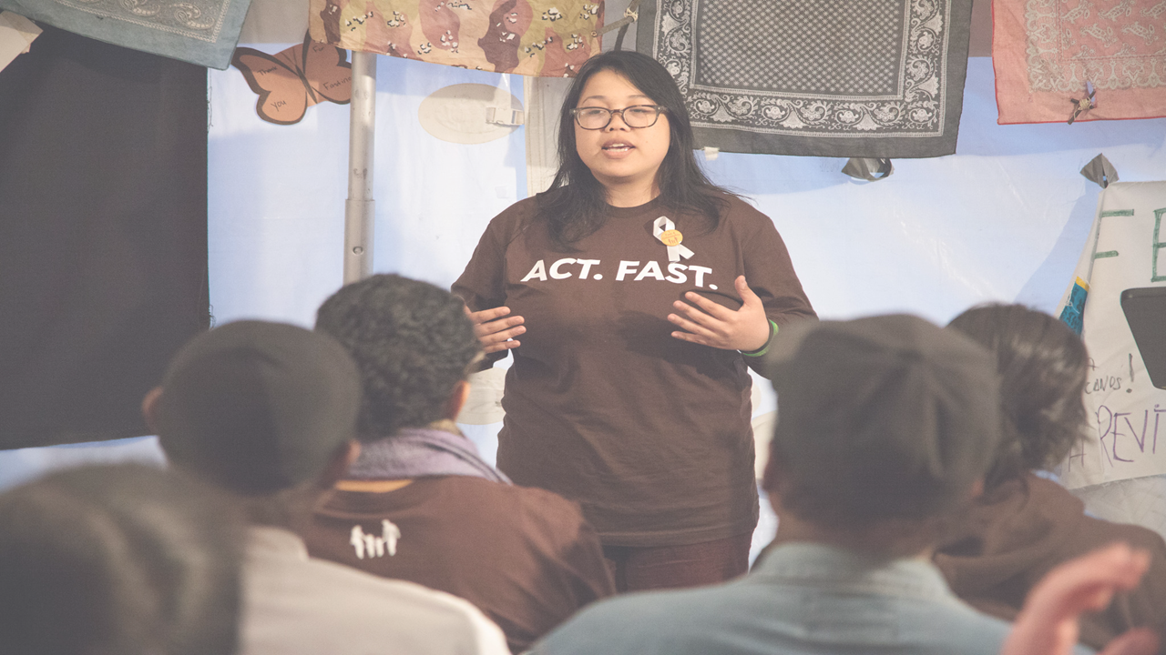
Why do we need women in leadership?
Notes:
Women bring unique skills and perspectives to leadership that are vital for our rural communities...especially as they are rapidly becoming more culturally diverse.
A study by Eldonna Sylivia showed that compared to male leaders, women are more likely to be: Nurturing, Democratic, Inclusive, Reciprocal, Creative, Resourceful, Open, and Accepting of Diversity.
It is particularly important to have women of color and Native American women in leadership because studies have shown they better represent the interests & issues of their communities.

Slide 15
Pilot Project
Notes:
Given this disparity of women in leadership, Teresa set out on a mission to figure out how to better support women and enable them to take on more leadership roles. Thanks to funding from RSDP and CURA, the pilot of 100 in 100 project was born.

Slide 16
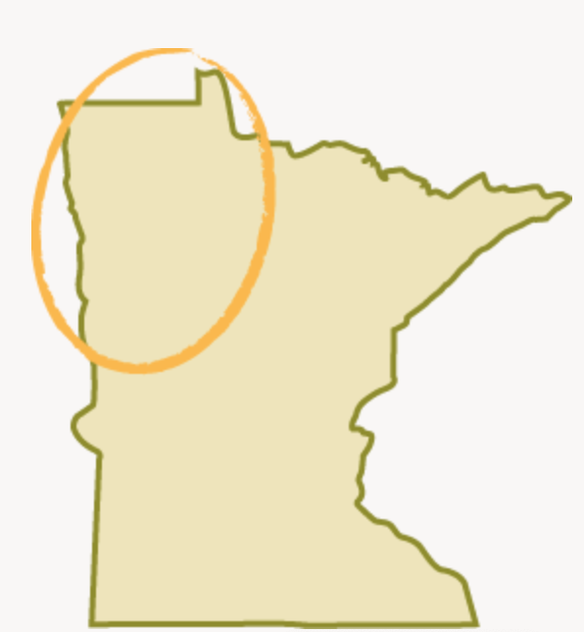
Pilot Project
Leech Lake Back of Ojibwe
Red Lake Band of Chippewa Indians
White Earth Reservation
Kittson County
Roseau County
Lake of the Woods County
Marshall County
Pennington County
Red Lake County
Clearwater County
Beltrami County
Polk County
Norman County
Mahnomen County
Clay County
Becker County
Hubbard County
Ottertail County
Wilkin County
Notes:
The pilot focused on NW Minnesota, which we roughly defined as these three Native Nations and sixteen counties.

Slide 17
What leadership barriers do women face in NW Minnesota?
Notes:
There were three main research questions we wanted to explore in the Pilot project.
The first was “What leadership barriers do women face in NW Minnesota?” After living in Bemidji I knew the answer to this question was snow. So. Much. Snow.
OK, in all seriousness, we wanted to know what ARE the main things holding women back (beyond the occasional snowstorm)?

Slide 18
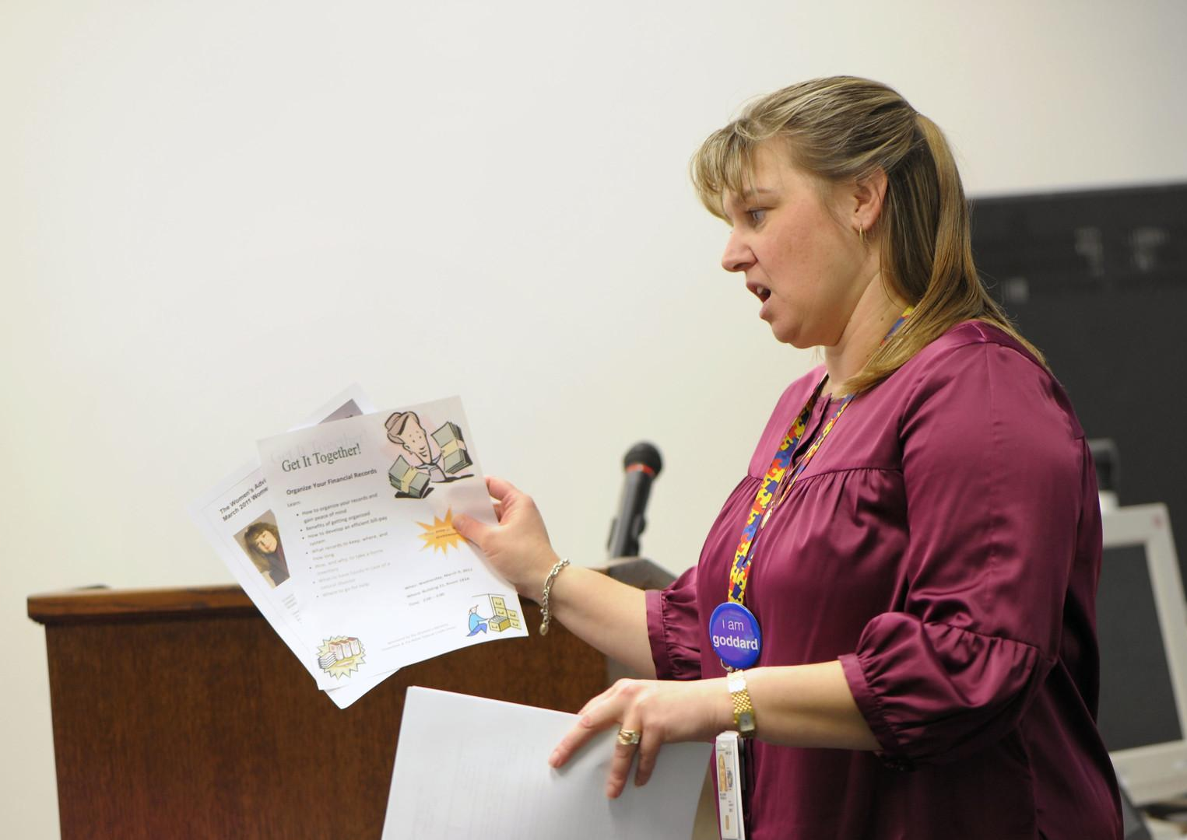
How can we support and empower women to take on more leadership roles?
Notes:
The second question was “How can we support and empower women to take on more leadership roles?”

Slide 19
How can we identify, connect and build stronger Women’s Networks in NW Minnesota?
Notes:
The third question was “How can we identify, connect, and build stronger networks in northwestern Minnesota?”

Slide 20
Pilot Project Phases
Notes:
There were four phases in the Pilot project.

Slide 21
Pilot Launch & Literature Review
Phase I:
September- November 2020
Notes:
In the lit review I looked at research related to women’s barriers to leadership in elected office, business, academia, and other fields; benefits and challenges of mentoring for women, and benefits and challenges of women’s networks. I also explored best practices in online focus group facilitation and online learning. I tried (with limited success) to find research focused on women’s leadership in rural areas or small towns.

Slide 22
Pilot Survey
Phase II:
December 2020- February 2021
Notes:
The second phase of the Pilot project was a survey targeting individuals who were
Women
Over the age of 18
Lived, worked, or had a connection to Northwestern Minnesota

Slide 23
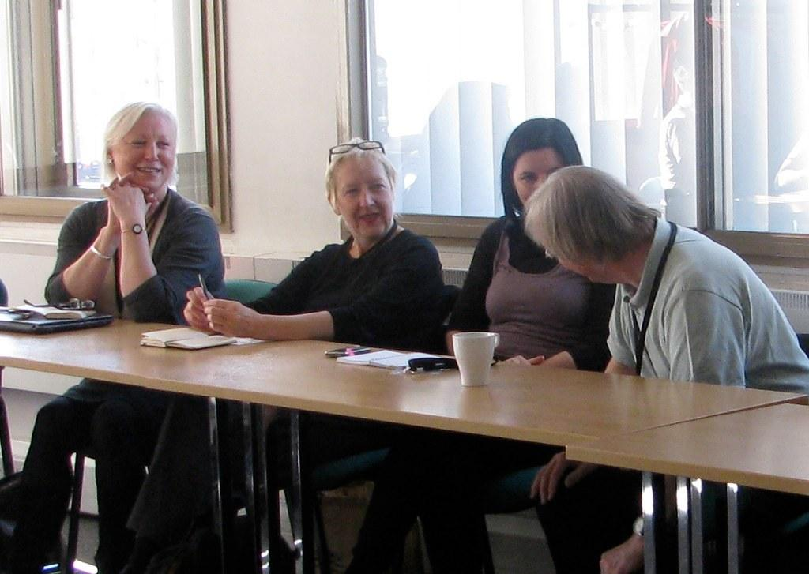
Pilot Convenings
Phase III:
March 2021
Notes:
The third phase of the Pilot project was a series of four Convenings (or online meetings) held over two weeks in March. online meetings

Slide 24
Pilot Wrap-Up & Preparing to Scale Up
Phase IV:
April-May 2021
Notes:
The last phase was to wrap up the Pilot project and prepare to scale up for the statewide launch of 100 in 100.
We also established a Facebook Group for NW MN women who participated in the Pilot project to continue to connect. If you are from NW, find us on Facebook! https://www.facebook.com/groups/100in100network/

Slide 25
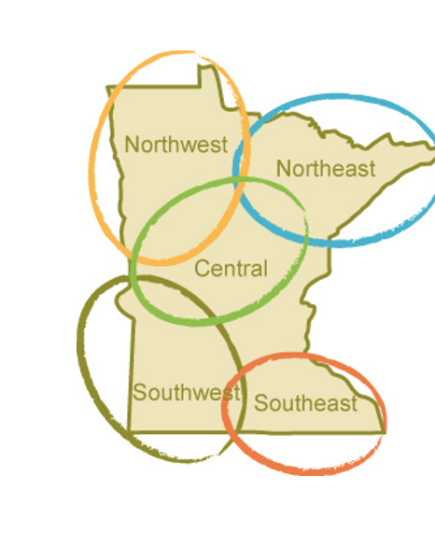
100 in 100 Statewide Project
Beginning Summer 2021
100 virtual convenings
All five regions of the state + Twin Cities Metro Area
Notes:
Beginning this summer (I guess that’s NOW...how is it June already?!)
100 in 100 will be moving across the state with the ultimate goal of holding 100 virtual convenings.

Slide 26
Pilot Project Findings
Notes:
Let’s dive in and look at the findings from our Pilot project that will inform the statewide project!

Slide 27
Survey Respondents by Age
Survey Respondents |  |  | NW Minnesota Statistics
 | Number of Respondents Age 18+ | Percentage of Respondents by Age Group | Percentage of Population by Age Group
Total Number of Respondents | 116 |  | (Total Population Age 18+: 100, 899)
Age 18-26 | 0 | 0% | 15%
Age 27-44 | 43 | 37% | 37%
Age 45-64 | 55 | 47% | 20%
Age 65+ | 18 | 16% | 27%
Survey Respondents |  |  | NW Minnesota Statistics
 | Number of Respondents Age 18+ | Percentage of Respondents by Age Group | Percentage of Population by Age Group
Total Number of Respondents | 116 |  | (Total Population Age 18+: 100, 899)
Age 18-26 | 0 | 0% | 15%
Age 27-44 | 43 | 37% | 37%
Age 45-64 | 55 | 47% | 20%
Age 65+ | 18 | 16% | 27%
https://www.mncompass.org/profiles/region/northwest
Notes:
The survey that we launched in Phase II resulted in 169 responses.
We used the “Snowball invitation” method: inviting an initial group of Connectors to extend the survey invitation to women in their networks, and so on.
There were 22 questions, of which six were demographic questions.
84% of our survey respondents were age 27-64

Slide 28
Survey Respondents by Race/ Ethnicity
Survey Respondents |  |  | NW Minnesota Statistics
 | Number of Respondents by Race/ Ethnicity | Percentage of Respondents by Race/ Ethnicity | Percentage of Population by Race/ Ethnicity
Total Survey Respondents | 113
People of Color | 12 | 11% | 14%
American Indian | 10 | 9% | 8%
Asian | 0 | 0% | 1%
Hispanic | 1 | 0.9% | 3.40%
Black or African American | 1 | 0.9% | 1%
Two or more races | 1 | 0.9% | 3%
White | 98 | 87% | 84%
Survey Respondents |  |  | NW Minnesota Statistics
 | Number of Respondents by Race/ Ethnicity | Percentage of Respondents by Race/ Ethnicity | Percentage of Population by Race/ Ethnicity
Total Survey Respondents | 113
People of Color | 12 | 11% | 14%
American Indian | 10 | 9% | 8%
Asian | 0 | 0% | 1%
Hispanic | 1 | 0.9% | 3.4%
Black or African American | 1 | 0.9% | 1%
Two or more races | 1 | 0.9% | 3%
White | 98 | 87% | 84%
https://www.mncompass.org/profiles/region/northwest
Notes:
At least 11% of our survey respondents were women of color (of the women who answered the questions about race and ethnicity).

Slide 29
Survey Respondents by County
Survey Respondents |  |  | NW MN Statistics
 | Number of Respondentsby County | Percentage of Respondents by County | Population by County | Percentage of Population by County
Total Number of Survey Respondents | 169 |  | (Total Population: 332,741)
Becker | 10 | 6% | 34,011 | 10%
Beltrami | 20 | 12% | 46,403 | 14%
Clay | 6 | 4% | 63,446 | 19%
Clearwater | 9 | 5% | 8,821 | 3%
Hubbard | 10 | 6% | 21,019 | 6%
Kittson | 10 | 6% | 4311 | 1%
Lake of the Woods | 3 | 2% | 3771 | 1%
Mahnomen | 1 | 1% | 5501 | 2%
Marshall | 9 | 5% | 9,372 | 3%
Norman | 6 | 4% | 6520 | 2%
Otter Tail | 13 | 8% | 58,195 | 17%
Pennington | 10 | 6% | 14183 | 4%
Polk | 29 | 17% | 31,521 | 9%
Red Lake | 5 | 3% | 4015 | 1%
Roseau | 4 | 2% | 15,361 | 5%
Wilkin | 0 | 0% | 6,291 | 2%
Connection to NW | 24 | 14%
Survey Respondents |  |  | NW MN Statistics
 | Number of Respondentsby County | Percentage of Respondents by County | Population by County | Percentage of Population by County
Total Number of Respondents | 169 |  | (Total Population: 332,741)
Becker | 10 | 6% | 34,011 | 10%
Beltrami | 20 | 12% | 46,403 | 14%
Clay | 6 | 4% | 63,446 | 19%
Clearwater | 9 | 5% | 8,821 | 3%
Hubbard | 10 | 6% | 21,019 | 6%
Kittson | 10 | 6% | 4311 | 1%
Lake of the Woods | 3 | 2% | 3771 | 1%
Mahnomen | 1 | 1% | 5501 | 2%
Marshall | 9 | 5% | 9,372 | 3%
Norman | 6 | 4% | 6520 | 2%
Otter Tail | 13 | 8% | 58,195 | 17%
Pennington | 10 | 6% | 14183 | 4%
Polk | 29 | 17% | 31,521 | 9%
Red Lake | 5 | 3% | 4015 | 1%
Roseau | 4 | 2% | 15,361 | 5%
Wilkin | 0 | 0% | 6,291 | 2%
Connection to NW | 24 | 14%
https://www.minnesota-demographics.com/counties_by_population
Notes:
The highest number of responses were from Polk County, and our herculean outreach effort to identify women in every county resulted in getting survey results from across the region.
(Unknown county=4)

Slide 30
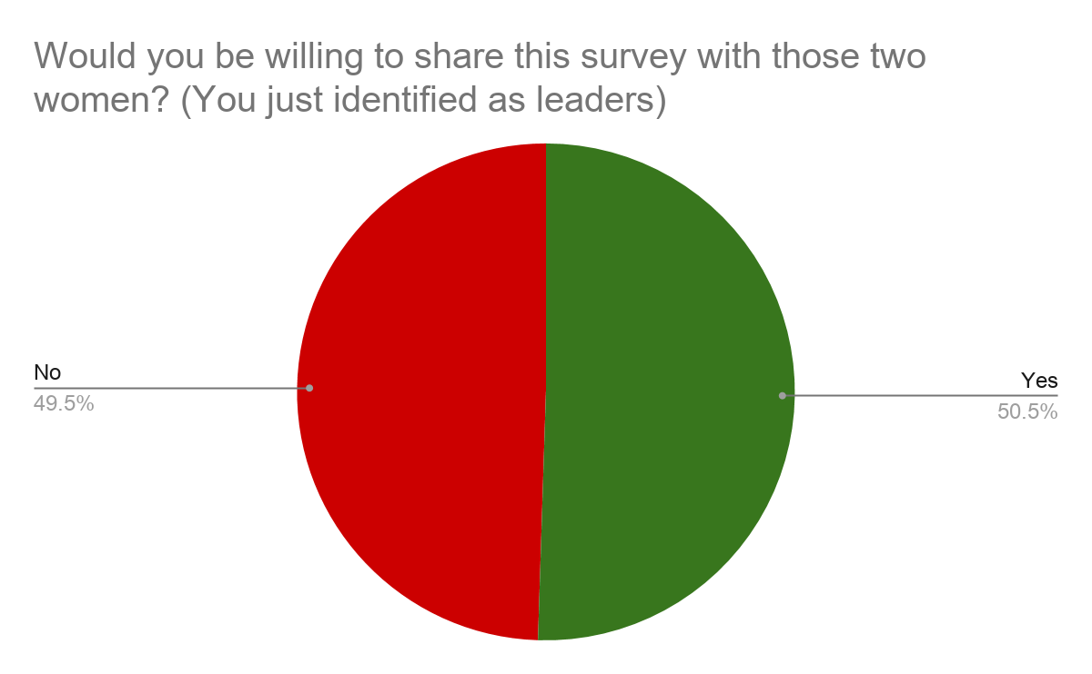
Willingness to share the survey

Slide 31
Convening Participants by Age
Convening Participants |  |  | NW Minnesota Demographics
 | Number of Participants Age 18+ | Percentage of Participants by Age Group | Percentage of Population by Age Group
Total Number of Participants | 41 |  | (Total Population Age 18+: 100, 899)
Age 18-26 | 1 | 2% | 15%
Age 27-44 | 17 | 41% | 37%
Age 45-64 | 16 | 39% | 20%
Age 65+ | 4 | 10% | 27%
Unknown | 3 | 7%
Convening Participants |  |  | NW Minnesota Demographics
 | Number of Participants Age 18+ | Percentage of Participants by Age Group | Percentage of Population by Age Group
Total Number of Participants | 41 |  | (Total Population Age 18+: 100, 899)
Age 18-26 | 1 | 2% | 15%
Age 27-44 | 17 | 41% | 37%
Age 45-64 | 16 | 39% | 20%
Age 65+ | 4 | 10% | 27%
Unknown | 3 | 7%
https://www.mncompass.org/profiles/region/northwest
Notes:
The four Convenings held during Phase III had two main goals:
Conduct a focus group-- get feedback on how to establish a women’s network that could provide support & help rural women overcome barriers to leadership.
Provide networking time that would allow participants to see what a women’s network could offer.
At these 90-minute Convenings, all conducted virtually via Zoom, we hosted a total of 41 Participants. They self- selected after receiving a mass invitation to our newly established contact list (many of them survey respondents), or on the website or social media.
Similar to the survey, 80% of the participants in our four pilot Convenings were age 27-64.

Slide 32
Convening Participants by Race/ Ethnicity
Convening Participants |  |  | NW Minnesota Demographics
 | Number of Participants by Race/ Ethnicity | Percentage of Participants by Race/ Ethnicity | Percentage of Population by Race/ Ethnicity
Total Participants | 41
People of Color | 4 | 10% | 14%
American Indian | 3 | 7% | 8%
Asian | 1 | 2% | 0.90%
Hispanic | 0 | 0% | 3.40%
Black or African American | 0 | 0% | 1%
Two or more races | 0 | 0% | 3%
White | 37 | 90% | 84%
Convening Participants |  |  | NW Minnesota Demographics
 | Number of Participants by Race/ Ethnicity | Percentage of Participants by Race/ Ethnicity | Percentage of Population by Race/ Ethnicity
Total Participants | 41
People of Color | 4 | 10% | 14%
American Indian | 3 | 7% | 8%
Asian | 1 | 2% | 0.90%
Hispanic | 0 | 0% | 3.40%
Black or African American | 0 | 0% | 1%
Two or more races | 0 | 0% | 3%
White | 37 | 90% | 84%
https://www.mncompass.org/profiles/region/northwest
Notes:
At least 10% of the Convening participants were women of color. (Of the women who indicated their race and ethnicity on the Registration Form)

Slide 33
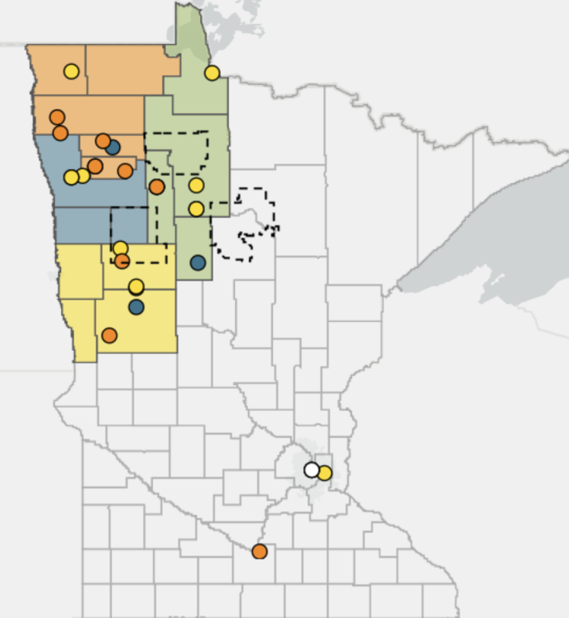
Convening Participants by County
Convening Participants |  |  | NW MN Statistics
 | Number of Participants by County | Percentage of Participants by County | Population by County | Percentage of Population by County
Total Number of Participants | 41 |  | (Total Population: 332,741)
Becker | 0 | 0% | 34,011 | 10%
Beltrami | 4 | 10% | 46,403 | 14%
Clay | 0 | 0% | 63,446 | 19%
Clearwater | 2 | 5% | 8,821 | 3%
Hubbard | 1 | 2% | 21,019 | 6%
Kittson | 2 | 5% | 4311 | 1%
Lake of the Woods | 1 | 2% | 3771 | 1%
Mahnomen | 0 | 0% | 5501 | 2%
Marshall | 3 | 7% | 9,372 | 3%
Norman | 2 | 5% | 6520 | 2%
Otter Tail | 5 | 12% | 58,195 | 17%
Pennington | 2 | 5% | 14183 | 4%
Polk | 5 | 12% | 31,521 | 9%
Red Lake | 2 | 5% | 4015 | 1%
Roseau | 1 | 2% | 15,361 | 5%
Wilkin | 0 | 0% | 6,291 | 2%
Connection to NW | 6 | 15%
Convening Participants |  |  | NW MN Statistics
 | Number of Participants by County | Percentage of Participants by County | Population by County | Percentage of Population by County
Total Number of Participants | 41 |  | (Total Population: 332,741)
Becker | 0 | 0% | 34,011 | 10%
Beltrami | 4 | 10% | 46,403 | 14%
Clay | 0 | 0% | 63,446 | 19%
Clearwater | 2 | 5% | 8,821 | 3%
Hubbard | 1 | 2% | 21,019 | 6%
Kittson | 2 | 5% | 4311 | 1%
Lake of the Woods | 1 | 2% | 3771 | 1%
Mahnomen | 0 | 0% | 5501 | 2%
Marshall | 3 | 7% | 9,372 | 3%
Norman | 2 | 5% | 6520 | 2%
Otter Tail | 5 | 12% | 58,195 | 17%
Pennington | 2 | 5% | 14183 | 4%
Polk | 5 | 12% | 31,521 | 9%
Red Lake | 2 | 5% | 4015 | 1%
Roseau | 1 | 2% | 15,361 | 5%
Wilkin | 0 | 0% | 6,291 | 2%
Connection to NW | 6 | 15%
https://www.minnesota-demographics.com/counties_by_population
Notes:
Similar to the Survey we had attendees from most of the counties in Northwestern Minnesota represented at the Pilot Convenings.
(Unknown county=4)
https://docs.google.com/spreadsheets/d/1lF7RyukKlTuNQ_SZEPLTLSaN9xhBGksPnm1r04SkGfg/edit#gid=1647698734

Slide 34
Agenda
Welcome & Introduction to the 100 in 100 Project | 15 min.
Small Group Discussions in Breakout Rooms Introductions Share examples of a women leader in your community | 15 min.
Focus Group Report out from small group discussions Discuss research findings Individual work time on Jamboard Large group discussion of Jamboard responses | 45 min.
Network Building Partner discussions Challenge to “Close a triangle” | 10 min.
Closing & Evaluation | 5 min.
Notes:
How much time should be devoted to Network building versus focus group?
Done with this slide by 7:35

Slide 35
Pilot Convenings
March 2021
Sun. | Mon. | Tues. | Wed. | Thurs. | Fri. | Sat.
 | 1 | 2 | 3 | 4 Convening 1 7:00-8:30 p.m. | 5 | 6 Convening 2 8:30-10:00 a.m.
7 | 8 | 9 Convening 3 3:00-4:30 p.m. | 10 | 11 | 12 Convening 4 12:00-1:30 p.m. | 13

Slide 36
Data Sources from Convenings
Registration (google form)
Menti poll (1st Convening)
Shared facilitator notes
Jamboard
Transcript of large group discussions
Chat box
Final Thoughts eval (google form)
Notes:
In Phase III the Convenings yielded many sources of data-- from the registration form to an online evaluation form.

Slide 37
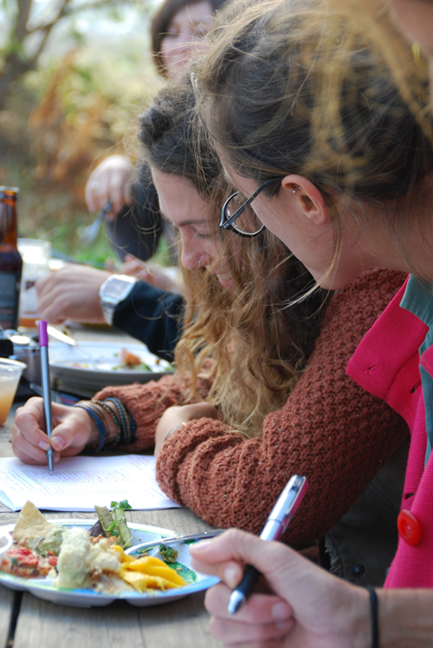
Research Limitations
Small sample size
Response bias
Notes:
Although we exceeded our goal of 100 survey respondents, quantitative researchers would say that our study had a relatively small sample size.
In addition, because we did not have a random sample, the results also reflect a response bias. The women who took the survey and participated in the Convenings were self-selected, so the results may overrepresent certain groups or interests (such as leadership. Over 70% of our survey respondents self-identified as a leader, so clearly our project on women’s leadership attracted women who are already interested in leadership.)
However, in my quantitative analysis, the significance tests showed there were almost no statistically significant differences in the responses of self-identified leaders and non-leaders.

Slide 38
Research Limitations
“network”
“Leadership”
Notes:
Although our team used the term “networks” internally, we realized that many women do not use this term to describe community groups that they are involved in. We emphasized that we were using “networks, organizations, or groups that you are part of” interchangeably.
Our study also faced the challenge of defining leadership. Some women have a negative association with the word “leader” or think only of Leadership (with a capital L) in terms of publicly elected or appointed positions, instead of other kinds of leadership in more private family and community spaces. After exploring this in the first Convening with this Menti poll, we determined that it would take more than 90 minutes to construct a definition of leadership, so in the next three Convenings we encouraged participants to think broadly about leadership.

Slide 39
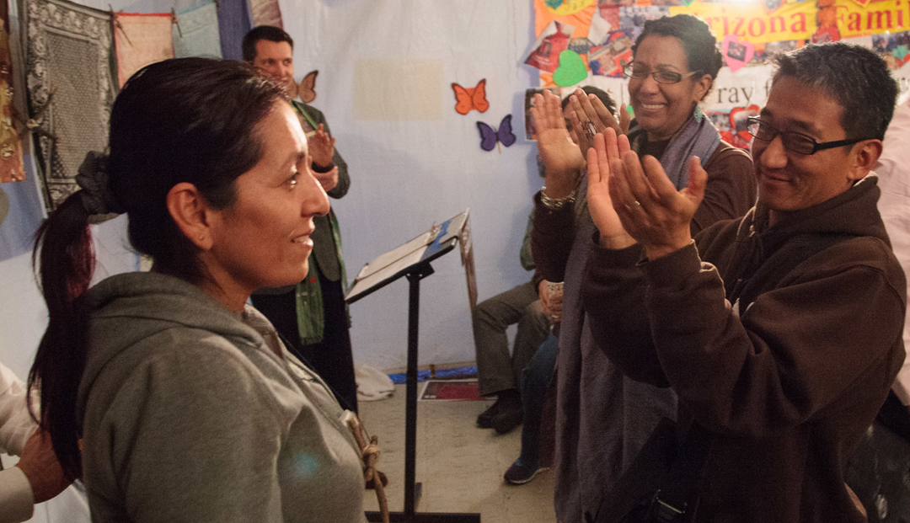
Different ideas of leadership
Notes:
One Convening Participant captured some of these different ideas around leadership, saying,
“I like the definition of a leader as someone who brings out the best in others. I could get behind that, that is more aligned with who I am. We need to get away from traditional, stagnant ideas of leadership around power and privilege and money.”

Slide 40
Research Limitations
Snapshot in time: COVID
https://www.qualityassurancemag.com/article/2020-a-year-to-remember-or-forget/
Notes:
Women’s experiences this year crossed a wide spectrum. For some, COVID was a positive time, while for others it brought illness, loss, and isolation.
For example, one woman remarked that “COVID has led me to virtual communities to create art, do yoga, and write stories.” Convening Participant.
Another talked about feeling disconnected from her work colleagues, saying “It’s hard to see behind the screen what’s REALLY going on with someone’s life. You forget to be real and let people in when it’s just a screen. I feel like we find it easier to ‘mute’ ourselves in more way than one now.”
We were conducting this research study in the midst of a once-in-a-century global pandemic, and acknowledge that what we heard from women reflects where they are at during this very complicated time. It will be interesting to see if the findings of the Pilot hold as life changes in the Post-COVID world.

Slide 41
What leadership barriers do women face in NW Minnesota?
Notes:
So what did we find out about barriers to women’s leadership?

Slide 42
Different Kinds of Barriers for Women
Structural Barriers
Institutional Mindsets
Individual Mindsets
Notes:
There are different kinds of barriers for women. Some describe them in terms of external and internal barriers, or societal and individual. One framework I liked describes barriers for women in terms of three buckets: structural barriers, institutional mindsets, and individual mindsets.
In our survey, we asked five questions that were related to barriers.

Slide 43
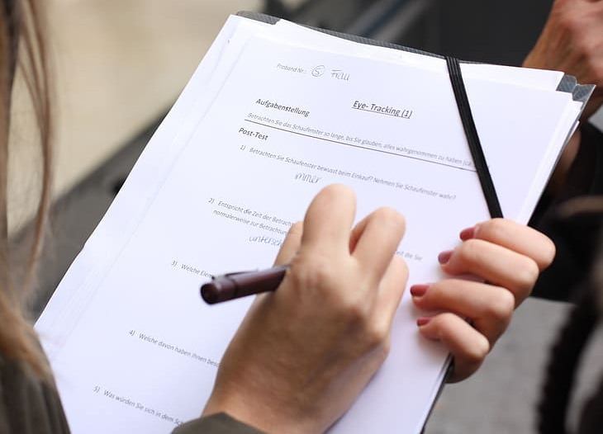
Survey questions about barriers
Do you agree with the following statements?
What barriers have you faced in taking on more leadership in these networks?
Do you think other people see you as a leader?
Name one woman in your community who you see as a leader. Why?
Name one woman in your community who you see as having the potential to be a good leader. Why?
Notes:
Do you agree with the following statements? (Not at all, Somewhat, Strongly Agree)--> what are the barriers for women in general, three buckets: structural barriers, institutional mindsets, individual mindsets
What barriers have you faced in taking on more leadership in these networks?--> what have been the barriers for you personally?
Do you think other people see you as a leader? (individual mindset)
Name one woman in your community who you see as a leader. Why? (definition of leadership, structural barriers)
Name one woman in your community who you see as having the potential to be a good leader. Why?

Slide 44
Do you agree with the following statements?
(Strongly Agree, Somewhat, Not at all)
Women are held to the same standards as men.
Employers offer women equal opportunities for advancement.
Women do more “office housekeeping” jobs.
Women leaders get support from the community.
Most people believe women can be good leaders.
Women leaders are as skilled as men.
Women are as likely to ask for promotions and raises.
Women are tough enough for leadership.
Women have the experience needed to be a leader.
Women see themselves as leaders.
Women are confident and take risks.
Women communicate their desire for new assignments or promotions.
Women have access to supportive mentors.
Women have equal access to informal social networks (happy hours, softball team, golf)
Women have more equal caregiving responsibilities to men.

Slide 45
Results
Women have more caregiving responsibilities.
2. Employers do not offer women
opportunities for advancement.
3. Women are not held to the
same standards as men.
4. Women are less likely to ask for
promotions and raises.
5. Women do not have equal
access to informal social networks.
6. Women do not have access to
supportive mentors.
Notes:
When asked to rate the most significant barriers for women in general, survey respondents identified care giving responsibilities as the #1 barrier.
Second was the perception that employers do not provide women opportunities for advancement. Gender bias, assumptions about who the “breadwinner” is in a household, and community beliefs about who should have power may all be playing into employers decisions about promotions. As one survey respondent said, “Men are the leaders in our community.”
The #3 barrier identified by women was the “double standards” that women face. As one Survey Respondent said, “I think women have to be more organized, smarter, and more composed. Sometimes if we are assertive, we are seen as aggressive. Sadly, I think we have a long way to go... Rural Minnesota still holds on to some of those archaic beliefs about a woman’s role. Sometimes I feel like it is a game we have to play to be heard.”

Slide 46
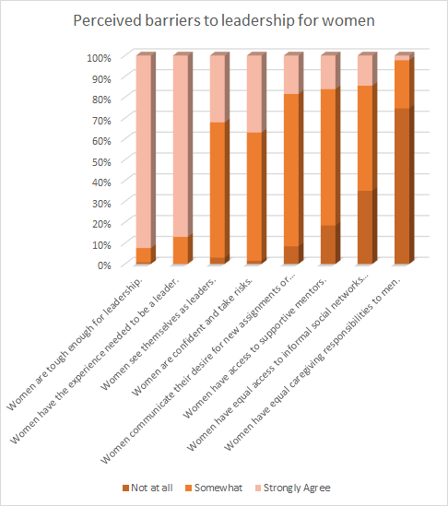
Results
Notes:
If you want to look more closely at the responses to all fifteen of these statements, Teresa will be sharing the full presentation after the webinar.

Slide 47
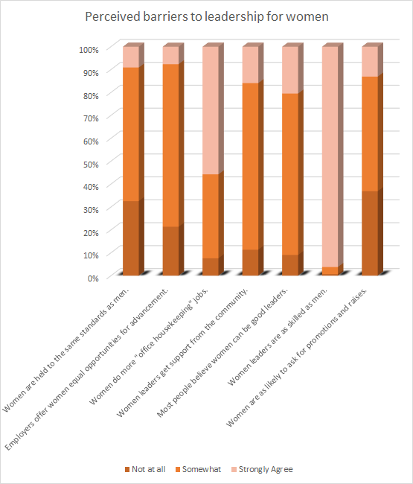
Results
Notes:
All of the top three barriers are related to two of the buckets: institutional mindsets (such as community pressures and gender roles) and structural barriers (such as promotion practices). In fact, if we look at all of the top six barriers identified for women’s leadership in general, only one is related to women’s individual mindset or lack of confidence in their abilities. (How likely a woman is to ask for promotions and raises.) So how much of the disparity in women’s leadership is related to the third bucket: individual mindsets?

Slide 48
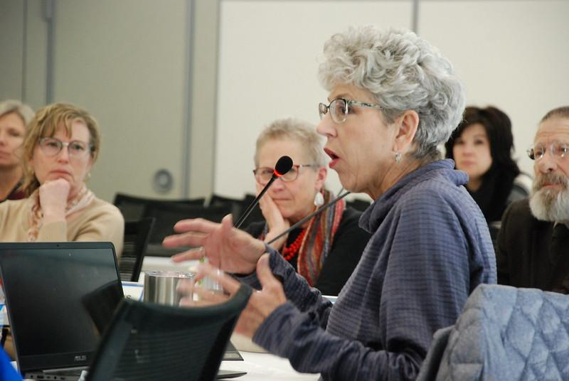
Individual Mindsets
Notes:
Survey Respondents overwhelmingly believe that women are as skilled, experienced, and have the toughness required for leadership. Women felt most strongly about the statement: “Women leaders are as skilled as men.” (93%)
Interestingly, when another survey question asked how to help other women like you develop leadership skills, a large number of women made comments related to building confidence or skills such as self-advocacy. Many comments in the Convenings also referenced lack of confidence or self-doubt as a barrier to women’s leadership.
One participant said, “When women are put into leadership roles we almost become apologetic. We aren’t a bitch, we are just being assertive. Sometimes women have to be more assertive because others don’t see the vision. Stop being apologetic about leadership when we are put into it.”

Slide 49
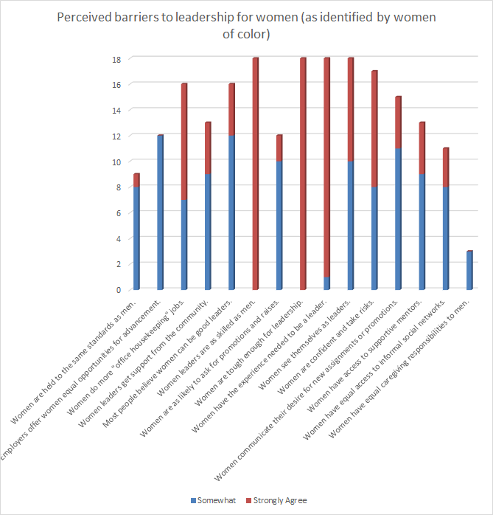
Results
Notes:
Women of color also identify the greatest barrier to leadership as caregiving responsibilities.
Almost universally agree (strongly!) that: Women are as skilled as men AND Women are tough enough for leadership.
Also believe strongly that: Women have the experience needed to be a leader.

Slide 50
Is there a difference between how leaders and non-leaders perceive barriers?
Notes:
70% of our survey respondents believe that others “probably or definitely” see them as a leader.

Slide 51
Results
What “communities” (or networks or organizations) are you involved in? (Check all that apply.)
Have you had leadership roles in these networks?
Q4_6: Do you agree with the following statement?
Women leaders are as skilled as men.
Marginally significant difference between leaders and non-leaders.
Prior Leadership role |  | Q4_1 | Q4_2 | Q4_3 | Q4_4 | Q4_5 | Q4_6 | Q4_7 | Q4_8 | Q4_9 | Q4_ 10 | Q4_ 11 | Q4_ 12 | Q4_ 13 | Q4_ 14 | Q4_ 15
Mean if no leadership role |  | 0.74 | 0.97 | 1.62 | 1.03 | 1.06 | 2.00 | 0.79 | 1.91 | 1.88 | 1.24 | 1.24 | 1.06 | 1.03 | 0.74 | 0.21
Mean if leadership role |  | 0.78 | 0.84 | 1.46 | 1.07 | 1.13 | 1.94 | 0.74 | 1.93 | 1.86 | 1.32 | 1.40 | 1.13 | 0.99 | 0.88 | 0.33
p-value |  | 0.70 | 0.26 | 0.20 | 0.70 | 0.47 | 0.06 | 0.69 | 0.84 | 0.79 | 0.41 | 0.11 | 0.55 | 0.73 | 0.29 | 0.21
Notes:
There is a marginally significant difference between leaders and non-leaders in our survey sample because the p-value is 0.058. If the p-value were less than 0.05 then it would be statistically significant.

Slide 52
Is there a difference between how younger and older women perceive barriers?

Slide 53
Results
What is your age group?
17 or younger
18-26
27-44
45-64
65+
No statistically significant difference between the responses of younger and older women.
Age over 45 |  | Q4_1 | Q4_2 | Q4_3 | Q4_4 | Q4_5 | Q4_6 | Q4_7 | Q4_8 | Q4_9 | Q4_ 10 | Q4_ 11 | Q4_ 12 | Q4_ 13 | Q4_ 14 | Q4_ 15
Mean if under age 45 |  | 0.74 | 0.95 | 1.47 | 1.09 | 1.14 | 1.98 | 0.74 | 1.95 | 1.88 | 1.30 | 1.37 | 1.12 | 1.05 | 0.77 | 0.24
Mean if over age 45 |  | 0.79 | 0.85 | 1.53 | 1.04 | 1.10 | 1.94 | 0.76 | 1.90 | 1.86 | 1.28 | 1.32 | 1.08 | 0.96 | 0.88 | 0.32
p-value |  | 0.66 | 0.30 | 0.59 | 0.65 | 0.69 | 0.43 | 0.90 | 0.33 | 0.73 | 0.80 | 0.62 | 0.75 | 0.47 | 0.42 | 0.38

Slide 54
Is there a difference between how white women and women of color perceive barriers?

Slide 55
Results
Regardless of your answer to the previous question, please check one or more of the following groups which you consider yourself a member.
Black or African American
American Indian or Alaska Native
Asian
Native Hawaiian or Other Pacific Islander
White
Other: __________
Are you Hispanic or Latinx?
Yes
No
Prefer not to respond
Q4_8: Do you agree with the following statement?
Women are tough enough for leadership.
Statistically significant difference between the responses of white women and women of color.
Race/ Ethnicity |  | Q4_1 | Q4_2 | Q4_3 | Q4_4 | Q4_5 | Q4_6 | Q4_7 | Q4_8 | Q4_9 | Q4_ 10 | Q4_ 11 | Q4_ 12 | Q4_ 13 | Q4_ 14 | Q4_ 15
Mean if white |  | 0.76 | 0.89 | 1.54 | 1.05 | 1.10 | 1.96 | 0.71 | 1.93 | 1.87 | 1.26 | 1.33 | 1.08 | 1.00 | 0.81 | 0.28
Mean if woman of color |  | 0.60 | 0.64 | 1.43 | 0.93 | 1.07 | 2.00 | 0.86 | 2.00 | 1.93 | 1.47 | 1.47 | 1.14 | 0.93 | 0.80 | 0.20
p-value |  | 0.36 | 0.11 | 0.57 | 0.54 | 0.82 | 0.10 | 0.45 | 0.02 | 0.38 | 0.16 | 0.45 | 0.75 | 0.73 | 0.95 | 0.50

Slide 56
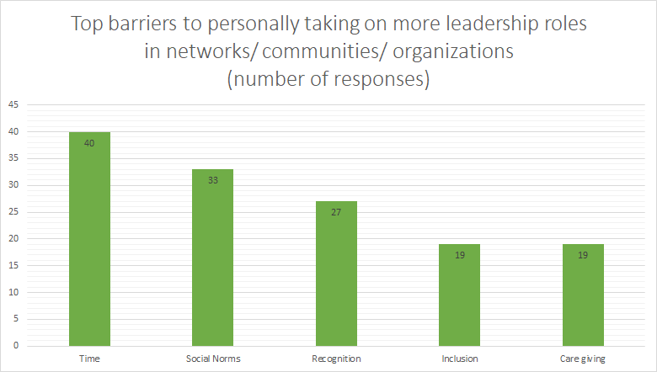
Personal Barriers
Notes:
When asked about the barriers they had PERSONALLY faced in taking on more leadership roles in networks, the results largely lined up with the barriers they identified for women in general. However, there were a few differences.
The largest number of women (40) made comments about TIME being the greatest barrier, as opposed to Care Giving responsibilities (identified as a barrier to women in general). As a mom myself, I can verify that these two could certainly be related. In the survey and in the Convening data, women mentioned time constraints relating to not only kids but also work, partners, pets, property, elder care, and single parenting.
After time, other personal barriers were social norms, recognition, inclusion, and care giving.

Slide 57
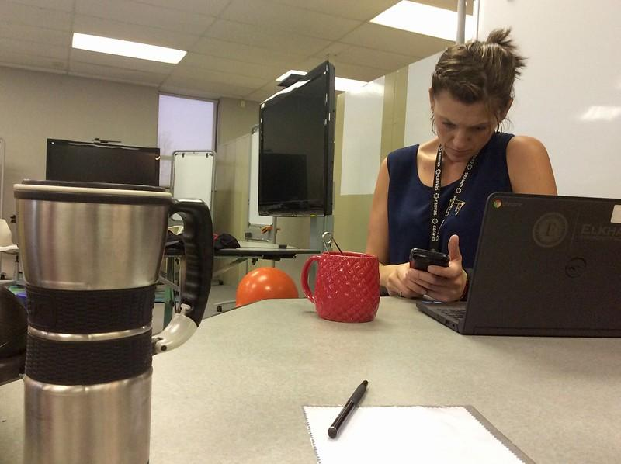
Time
Demands
Work/life balance
Notes:
Do any of you ever feel like this woman in the picture? It reminds me of what they call the “mental load” that mothers carry. This mom looks like she is trying to schedule carpool for her son’s soccer game during a break in her work meeting.
Survey respondents said things like the greatest barrier is “Time, always time” and “I run out of time to do it all.”
Women also commented in the survey and Conveings on things like juggling time for caring for children, work demands, dinners with husband, responsibilities at home, other activities, and time for self-care.
Time became even more of a challenge for some women during COVID, such as one who said “It is so hard to leave the computer or not go back to put in more time. You went from working within the structure. You had things that you wanted or needed to do after work, and so you had to stop working. Now there’s not a lot going on (due to COVID), and you just keep working, 24 hours a day.” Convening Participant

Slide 58
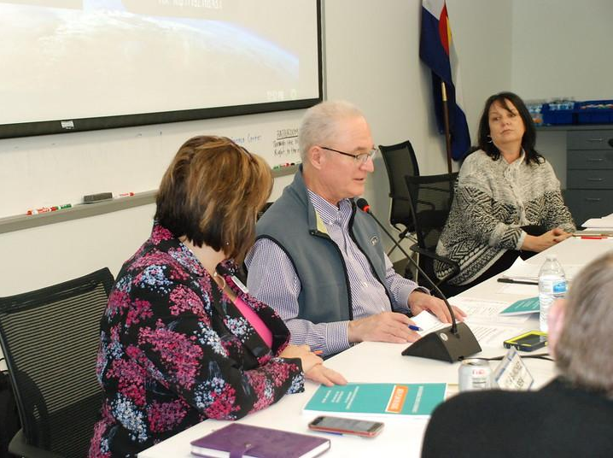
Social Norms
Men should be leaders
Newcomers aren’t ready for leadership
Women should do work for free.
Notes:
Social norms and ingrained community beliefs are also a major barrier for women’s leadership. One survey respondent said: “The biggest challenge in a small community is having full support as a female.”
Another said, “I have experienced the perceived notion that as a woman, I should automatically agree to be the committee Secretary, without being offered Chair or Vice Chair.” (Survey Respondent)
“Socioeconomics and racial barriers are factors in other leadership networks. Sometimes you get asked to be on a board because of the color of your skin, but they don’t want your input, you’re just a checked item on the list of inclusivity. I get asked to be on committees and panels for my expertise, but they get my work and knowledge for free when everyone else is on payroll.” Survey Respondent

Slide 59
Recognition
Safety
Authenticity
Being seen
Acknowledgement
Public support by Allies
Notes:
Recognition was called out as a personal barrier. One woman described this saying: “It is difficult to pinpoint, sometimes it just feels like my voice is not heard.”
Another said in a Convening “Women who are effective leaders are not afraid to be who they are and embracing that, authenticity. Not being afraid to be women. We’ve dressed like men or felt like we should act in a certain way and in lots of ways that’s what society demands of us as female leaders, but that is changing. Embrace who we are as women in terms of our thought process and our personality. That is more than enough and very, very powerful in its own right.” Convening Participant
Many commented on the need for Allies. One said, “Women are targets, especially on social media. It’s really debilitating to women to be attacked, so we have to have others speak up for us.” Convening Participant

Slide 60
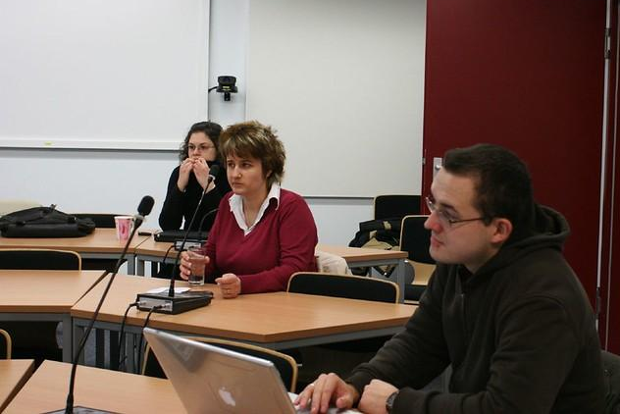
Inclusion
Communication
“Insider knowledge”
“Old Guard” versus newcomers
Openness to change
Notes:
Another barrier, that goes hand in hand with Recognition, is Inclusion. One woman said at a Convening that "As an outsider... it took a lot for me to even find out about things going on. Most of the advertising is on the radio, but I don't listen to the radio so I didn't know...and most of the businesses here in town have never had Facebook pages." Convening Participant
A woman said in her survey response that “In some instances when I have been in leadership roles, the men on the boards aren’t always supportive or willing to try doing things in new ways...frustrating!” Survey Respondent

Slide 61
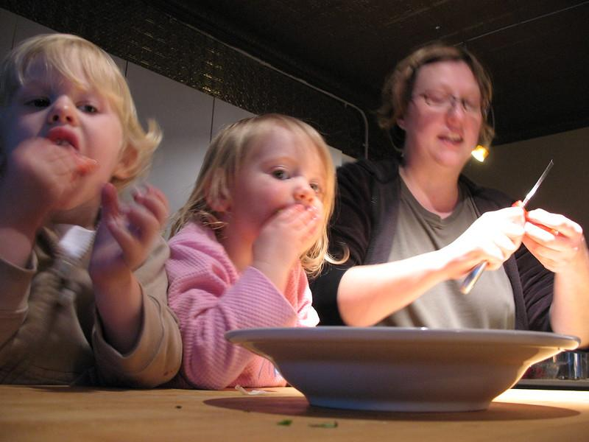
Caregiving
Children
Family
Single parenting
Notes:
Women of color are more likely to be single parents.
Many MN mothers are primary breadwinners:
36% white
51% Native American
37% Latina 32% Asian, 57% African American

Slide 62
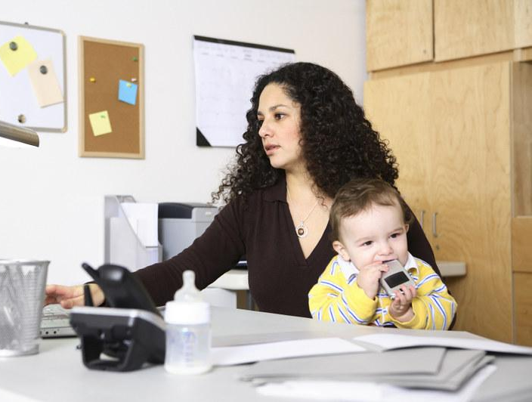
Caregiving Responsibilities
Child care
Elder care
Pets
Home
Relationships
Notes:
Finally, another top barrier that may overlap with Time is Care giving responsibilities. A survey respondent said, “Childcare! Most of the executives golf and network that way.”
Another said, “It’s important to me and my husband to have family dinners and time together. I won’t compromise family time for more leadership roles.” (Survey Respondent)
One woman at a Convening said, “Child care is huge. I’ve seen a couple of leadership programs that would be really great to be a part of. I had to turn it down because of the child care factor. We aren’t from here so I can’t drop a couple of young kids off with people that we aren’t familiar with for an extended length of time. I think childcare networks or having some kind of access to that would help women be able to take on leadership roles, positions, or trainings that I know are out there.” Convening Participant

Slide 63
How can we support and empower women to take on more leadership roles?
Notes:
What did our study reveal about how we can better support women?

Slide 64
Survey questions about supports:
What has your workplace done to support employees in taking on new opportunities?
Where do you get support for professional growth?
If there is something that could help other women like you develop leadership skills, what would it be?
Give one example of how another woman has guided or supported you.
What forms of education have helped you up to this point?

Slide 65
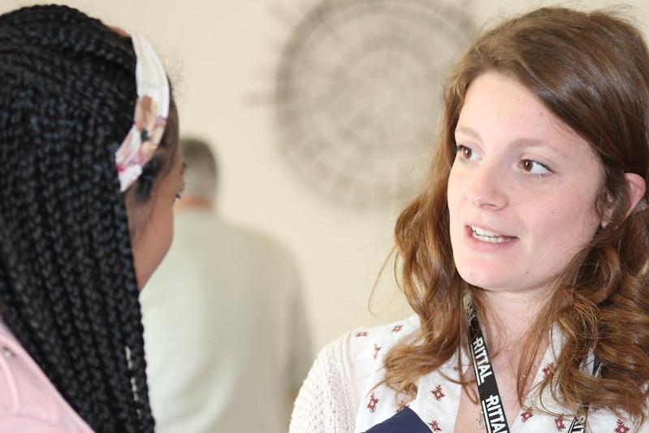
Emotional Support
Notes:
Encouraging others and providing emotional support was a theme that came up again and again in both the Convening and Survey.
One woman said, “It’s important to encourage women to step into these spaces to practice leadership. Sometimes it takes someone else saying ‘You can do this!’ or ‘You’d be great at that!’ Convening Participant

Slide 66
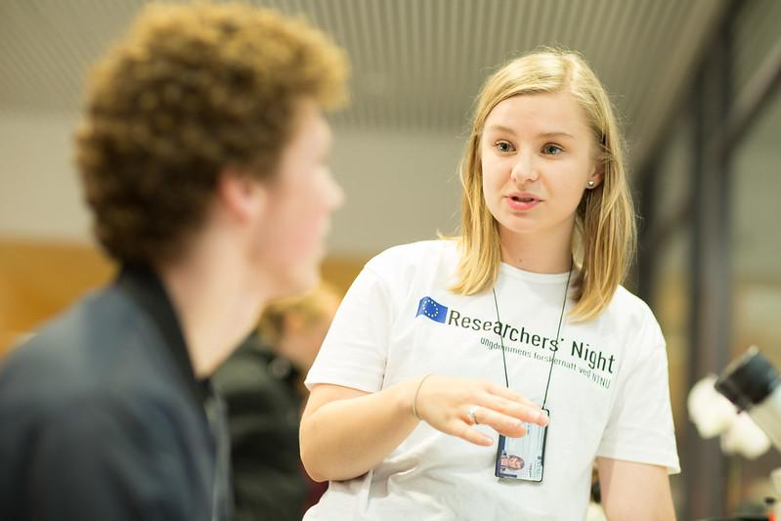
Identity
Notes:
Another thing we can do is to help women recognize their own potential.
One individual said, “A lot of women in my community are doing these things already, but it’s just what they do. They would not necessarily consider them leadership. It’s just what they do, as far as being female in their family or their community.” Convening Participant
Another stressed that, “Leaders can and should be cultivated from within the communities that are most impacted by the issues, problems, events that are relevant today. They have the solutions and ideas!” Convening Participant

Slide 67
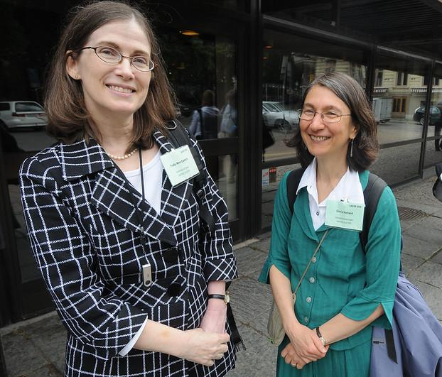
Mentors
Notes:
Many women in our study commented on how they need someone to “bounce ideas off” and that they learn from another woman’s wisdom and experience.
For example, one Convening participant said, “I try to help them take the first and then the second steps. The hardest thing to me is just taking that first step. Sometimes you don’t know how to start so having a mentor, someone else around to help you figure out that beginning... where you’re uncertain or where your next step is and where you need to go from there...that’s a big help for a lot of people.” Convening Participant.

Slide 68
How can we identify, connect and build stronger Women’s Networks in NW Minnesota?
Notes:
One way to provide guidance and support for women is through Networks. What did the study reveal about what a woman’s network should look like?

Slide 69
Survey questions about networks
What “communities” (or networks or organizations) are you involved in?
How do these communities/networks/organizations make newcomers feel welcome?
Do you have any leadership roles in these networks?
What leadership roles have you had?

Slide 70
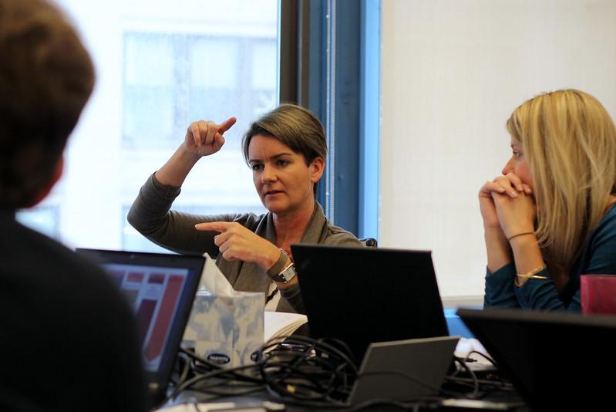
Modeling Leadership
Leadership stories
Onboarding
Practicing skills
Notes:
In the survey responses and Convening discussions, a theme that came up time and again was the need for learning leadership skills from someone intentionally modeling it. A dedicated women’s network could provide this opportunity to learn from one another. “We all need to get better at sharing our stories (the good, the bad, and what we’ve learned) so that others can be inspired” said one Convening Participant.
One woman said in her survey response that “There isn’t a lot of precedent on policies and procedures, relaying of information, and learning from experienced individuals. It’s more of a learn as you go situation...and confusion, miscommunication, and lack of follow-through tend to be the result of these types of leadership dynamics.” Survey respondent
In a Convening one woman talked about a supervisor who sat her down and had her run through specific leadership scenarios, coaching her on responses.

Slide 71
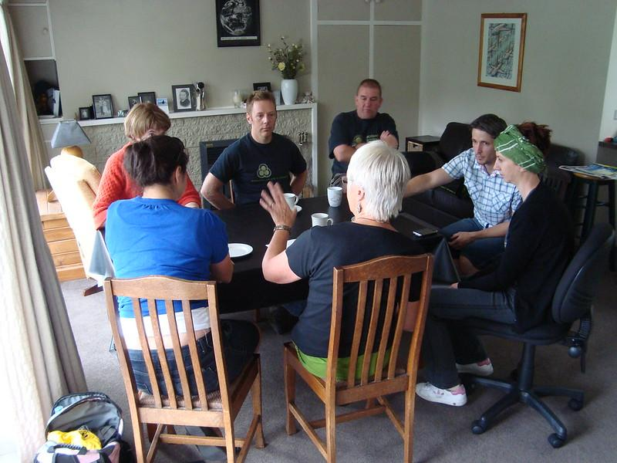
Inviting new leaders
Places to practice leadership
Notes:
Another important component of a women’s network is inviting new women into spaces to practice leadership. One woman said at a Convening, “I moved into my small community and it takes a while to get your footing. A woman reached out to me to ask if I could help with this project. She gave me the welcome mat to enter into a project and showcase my talents and strengths. She provided me an opportunity.” Convening Participant
Another said “We always look to the most senior person. I found out in the first meeting that the newest person was going to be the chair for the year. [That was me!] It was such an ideal way to learn people’s names and be in front of the group and call people to order. I practice that now as much as I can, particularly with young women who haven’t had many opportunities to be at the head of a room, hold everyone’s attention and make decisions on the spot. It is great practice.” Convening Participant

Slide 72
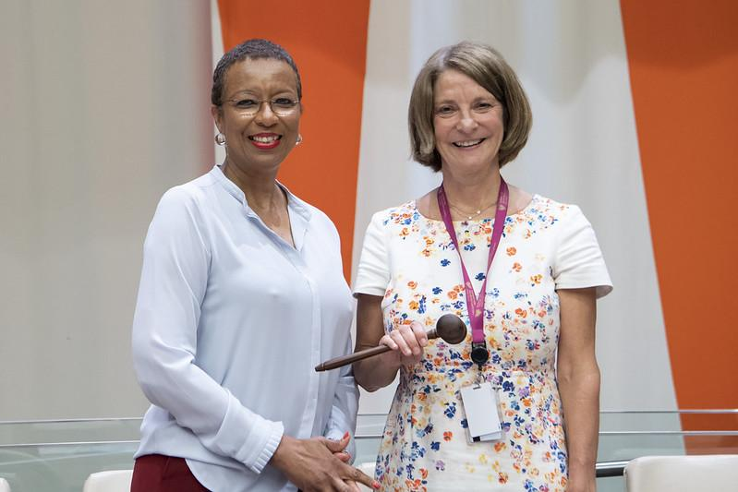
Sharing Leadership
Collaboration
Co-leading
Encouraging diverse perspectives
Notes:
Many women in the study made comments about the importance of collaborative leadership and sharing power.
One said, “Everyone had our roles even though she was the boss. We would call ourselves the ‘Women of the Round Table’ because that is how we would strategize.” Convening Participant
Another talked about how women are natural connectors who demonstrate web-like thinking.
In one Convening a woman said, “A diversity of backgrounds, lived experiences, and perspectives should be encouraged! It’s when differences of perspective and a variety of lenses can come together that we get a more complete, accurate picture of problems and solutions.” Convening Participant

Slide 73
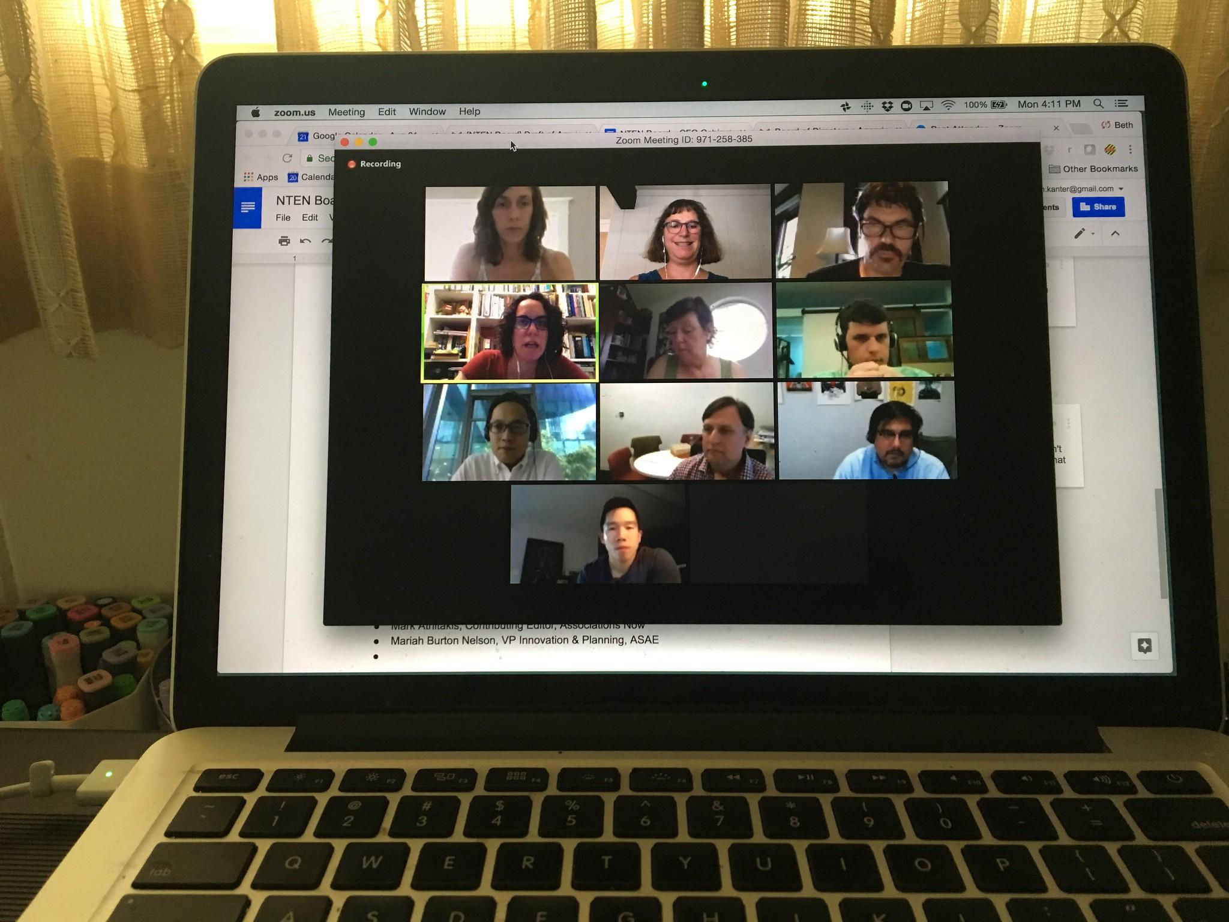
Save time with virtual opportunities?
Accessibility
Equity
Opportunities far away
Notes:
Many women commented in the survey and Convenings that virtual opportunities save time when you live in a rural area in NW MN. One said, “A year ago to have this Convening we would have had to invest many hours, energy, and a great deal of time and money.”
Another said, “While virtual isn’t ideal, it promotes equity and access.” Convening Participant

Slide 74
Recommendations
Provide childcare, meals, and any other time-savers
Virtual opportunities to connect
Provide women-focused leadership opportunities
Create safe spaces for women to practice leadership
Involve participants in leading meetings
Establish mentorships
Encourage leadership practices that are authentic for women
Network weaving, Collaborative leadership
Must address community mindsets and structural barriers!
Notes:
From the survey findings grew a few key recommendations for the 100 in 100 Project.
Provide childcare, meals, and any other time-savers
Virtual opportunities to connect
Provide women-focused leadership opportunities
Create safe spaces for women to practice leadership
Involve participants in leading meetings
Establish mentorships
Encourage leadership practices that are authentic for women
Network weaving, Collaborative leadership
Must address community mindsets and structural barriers!
One study participant said, “Strong community support is needed to encourage female leadership. Women have a high bar to clear in leadership roles as you must prove yourself.” Convening Participant
Another reiterated “Community development is incredibly important!” Convening Participant

Slide 75
How can 100 Rural Women:
help address barriers to women’s leadership?
support women leaders?
grow regional women’s networks?
Notes:
Teresa
7:57-8:00

Slide 76
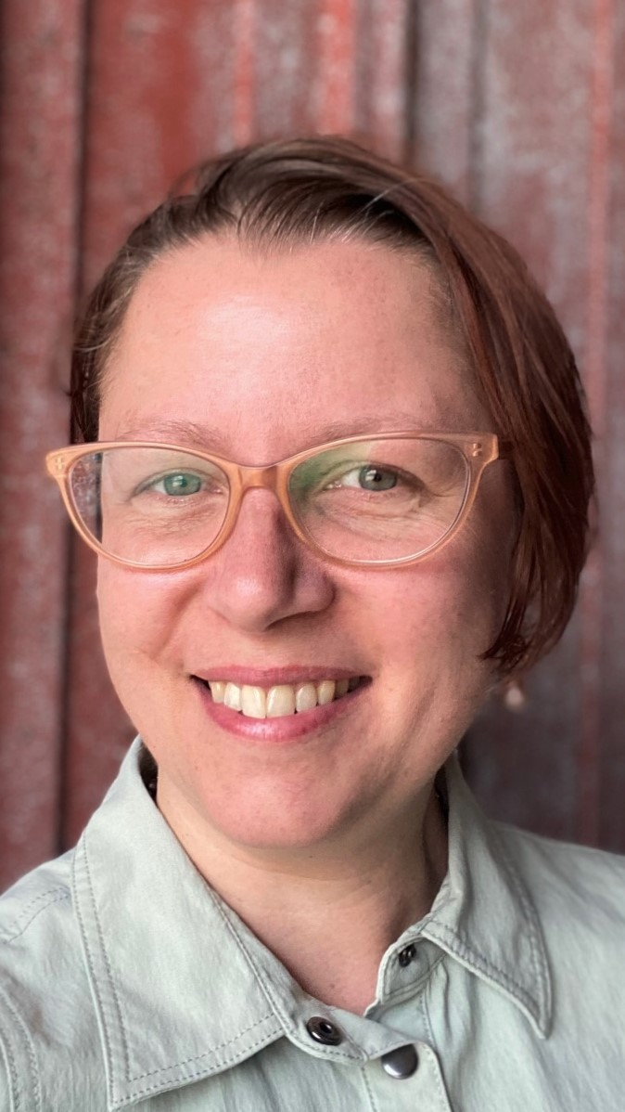
Thank you!
Kate Stower
stower.schlosser@gmail.com
612-280-5161
Feel free to contact me anytime…
especially if you are hiring!

